Slide 1
Chapter 9: Printers
IT Essentials 5.0
Notes:
Cisco Networking Academy Program
IT Essentials 5.0
Chapter 9: Printers

Slide 2
Chapter 9 Objectives
9.1 Describe the common features of printers
9.2 Describe the various types of printers
9.3 Describe how to install and configure printers
9.4 Describe and implement printer sharing
9.5 Identify and apply common preventive maintenance techniques for printers
9.6 Apply the troubleshooting process to troubleshoot printers
Notes:
Chapter 9 Objectives
The purpose of this chapter is to provide essential information
about printers. The topics include how printers operate, what to
consider when purchasing a printer, and how to connect printers
to an individual computer or to a network.
9.1 Describe the common features of printers
9.2 Describe the various types of printers
9.3 Describe how to install and configure printers
9.4 Describe and implement printer sharing
9.5 Identify and apply common preventive maintenance techniques for printers
9.6 Troubleshoot printers

Slide 3
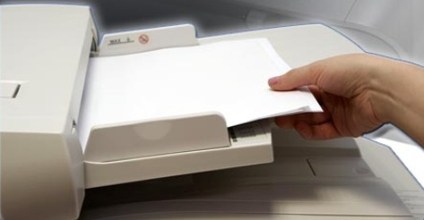
Introduction
Printers produce paper copies of electronic files.
  Hard copies of computer documents remain important today.
The technician must understand the operation of various types of printers to be able to install, maintain, and troubleshoot any problems that arise.
Notes:
9.0 Printers
9.0.1.1 Introduction
Printers produce paper copies of electronic files.
Scanners allow users to convert paper documents into electronic files.
Many government regulations require physical records; therefore, hard copies of computer documents are often as important today as they were when the paperless revolution began several years ago.
A technician must understand the operation of various types of printers and scanners to be able to install and maintain them, as well as troubleshoot any problems that may arise.
After completing this chapter, students will meet these
objectives:
Describe the types of printers currently available
Describe the installation and configuration process for printers
Identify and apply common preventive maintenance techniques for printers
Troubleshoot printers

Slide 4
Printers
As a computer technician, you may be required to purchase, repair, or maintain a printer.
Printer selection criteria:
  Capacity and Speed
  Color or black and white
  Quality
  Reliability
  Warranty
  Schedule servicing
  Mean time between failure (MTBF)
  Total Cost of Ownership (TCO)
Notes:
9.1 Common Printer Features
As a computer technician, you may be required to purchase,
repair, or maintain a printer. The following are tasks that a
customer may request from you:
Select a printer
Install and configure a printer
Troubleshoot a printer
9.1.1.1 Characteristics and Capabilities of Printers
Printers available today are usually either laser printers using electrophotographic technology or inkjet printers using electrostatic spray technology. Dot matrix printers using impact technology are used in applications that require carbon copies.
Printer capacity and speed are factors to consider when selecting a printer. Inkjet printers are usually slower, but they may be adequate for a home or small office. The speed of a printer is measured in pages per minute (ppm).
Price of a printer reflects its capacity and speed
A computer monitor produces colors through the additive mixing of dots that are displayed on the screen. The eye picks up the colors directly. The dots produce the color range using red, green, and blue (RGB) dots.
A printer produces colors using subtractive mixing. The eye sees a color that reflects from the combination of colors on the paper. The colors are cyan, magenta, yellow, and black (CMYK).
The choice between a black-and-white printer and a color printer depends on the needs of customers.
Quality is measured in dots per inch (dpi).
The more dpi, the higher the resolution.
Higher resolution means text and images are usually clearer.
To take advantage of high resolution, use high-quality ink or toner and high-quality paper.

Slide 5
Wired Printer Connection Types
To access a printer, a computer must have a compatible interface with it. The following are common interface types:
  Serial
  Parallel
  Small Computer System Interface (SCSI)
  Universal Serial Bus (USB)
  Firewire
  Ethernet
Notes:
9.1.1.2 Wired Printer Connection Types
To access a printer, a computer must have a compatible
interface with the printer. The following are common interface
types:
Serial data transfer is the movement of single bits of information in a single cycle
Serial ports are D-shell and are either male or female ports
The number of pins for each port may vary. Serial cables may have either a 9-pin connector or a 25-pin connector either end
The maximum length of a serial cable is 50 ft (15 m).
Parallel data transfer is the movement of multiple bits of information in a single
cycle.
Parallel data transfer is faster than serial data transfer
IEEE 1284 is the current standard for parallel printer ports. Enhanced Parallel Port (EPP) and Enhanced Capabilities Port (ECP) are two modes that allow bi-directional communication. IEEE 1284 standard allows for cable length up to 30 ft (10 m); for data reliability, 15 ft (4.5 m) cable lengths are recommended. Parallel cables may have a 1284 Type-A 25-pin DB 25 connector on one end, and a 36-conductor Centronics connector on the other end. The Type-A connector connects to a computer, while the Centronics connector connects to a printer.
Small Computer System Interface (SCSI), pronounced “scuzzy”, uses parallel
communication to achieve high data-transfer rates. Some types of SCSI:
SCSI 1 - 50 pin connector
SCSI 2 (fast SCSI) - 50 pin connector
SCSI 2 (wide SCSI) - 68 pin connector
SCSI 3 (fast/wide SCSI) - 68 pin connector
Universal Serial Bus (USB) is a common interface for printers and other devices
Speed and simple setup has made USB very practical. Newer operating systems offer plug and play (PnP) USB support, which automatically detects the device and installs the driver.
A USB printer cable is a four-wire cable that has two unique ends, labeled A and B. Rectangular A connector usually connects with the computer. Square-shaped B connector connects to the printer.
127 USB devices can attach to a single bus.
Firewire - Also known as i.LINK or IEEE 1394, is a high-speed, communication
bus that is platform independent.
Firewire connects devices such as printers, scanners, cameras
Allows a peripheral device to seamlessly plug into a computer
Devices are hot-swappable
A single plug-and-socket connection can attach up to 63 devices
Has a data transfer rate of up to 400 Mbps
Ethernet - An interface for network printers.
Network printers are usually a resource shared on a network
Typically have high-speed output and options such as LAN fax, duplex, and finishers
Most have an RJ-45 interface for an Ethernet connection

Slide 6
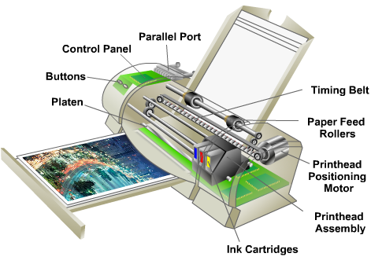
Inkjet Printers
Use ink-filled cartridges that spray ink onto a page through tiny holes, or nozzles. The ink is sprayed in a pattern on the page.
Two types of inkjet nozzles:
  Thermal
  Piezoelectric
They produce high quality prints, are easy to use, and are less expensive than laser printers. However, the nozzles are prone to clogging and the ink is wet after printing.
A feeding mechanism draws paper in and the paper passes by the print head where ink is sprayed onto it.
Notes:
9.2 Types of Printers
9.2.1.1 Inkjet Printers
Inkjet printers produce high quality prints. Inkjet printers are
easy to use and inexpensive compared to laser printers.
There are two types of inkjet nozzles:
Thermal - A pulse of electrical current is applied to heating chambers around the nozzles. The heat creates a bubble of steam in the chamber which forces ink out through the nozzle.
Piezoelectric crystals are located in the ink reservoir at the back of each nozzle. A charge is applied to the crystal causing it to vibrate. This vibration of the crystal controls the flow of ink onto the paper.
Inkjet Printer Components
Inkjet printers use ink cartridges that spray ink onto a page through tiny holes. The tiny holes are called nozzles and are located in the print head. The print head and ink cartridges are located on the carriage, which is attached to a belt and motor. As rollers pull paper in from the feeder, the belt moves the carriage back and forth along the paper as the ink is sprayed in a pattern on the page.
Inkjet printers use plain paper to make economical prints. Special-purpose paper may be used to create high-quality prints of photographs.
Print quality of an inkjet printer is measured in dots per inch (dpi). A higher dpi rating provides greater image detail.

Slide 7
Inkjet Printers (continued)
Advantages:
  Initial low cost
  High resolution
  Quick to warm up
Disadvantages:
  Nozzles are prone to clogging
  Ink cartridges are expensive
  Ink is wet after printing
Notes:
9.2.1.1 Describe inkjet printers

Slide 8
Laser Printers
A laser printer is a high-quality, fast printer that uses a laser beam to create an image. It uses the following process:
  Processing
  Charging
  Exposing
  Developing
  Transferring
  Fusing
  Cleaning
Notes:
9.2.1.2 Describe laser printers
The central part of the laser printer is its electrophotographic drum. When laser light strikes the drum, it becomes a conductor at the point where the light strikes. The laser beam draws an electrostatic image on the drum. The undeveloped image is passed by a supply of dry ink or toner that is attracted to it. The drum turns and brings this image in contact with the paper, which attracts the toner from the drum. A fuser melts the toner into the paper.
There are seven main components contained within a laser printer:
Toner cartridge
Laser scanner
High-voltage power supply
Paper transport mechanism
Transfer corona
Fuser assembly
Control circuitry
Ozone filter
NOTE:
You should know the components of a laser printer and the steps required to print
a page.
Laser Printing Process:
1. Processing - The data from the source must be converted into a printable form. The printer converts data from common languages, such as Adobe PostScript (PS) or HP Printer Command Language (PCL), to a bitmap image stored in the printer’s memory. Some laser printers have built in Graphical Device Interface (GDI) support. GDI is used by Windows applications to display printed images on a monitor so there is no need to convert the output to another format such as PostScript or PCL.
2. Charging - The previous latent image on the drum is removed and the drum is conditioned for the new latent image. A wire, grid, or roller receives a charge of approximately -600 volts DC uniformly across the surface of the drum. The charged wire or grid is called the primary corona. The roller is called a conditioning roller.
3. Exposing - To write the image, the photosensitive drum is exposed with the laser beam. Every portion of the drum that is scanned with the light has the surface charge reduced to about -100 volts DC. This electrical charge has a lower negative charge than the remainder of the drum. As the drum turns, an invisible latent image is created on the drum.
4. Developing - The toner is applied to the latent image on the drum. The toner is a negatively charged combination of plastic and metal particles. A control blade holds the toner at a microscopic distance from the drum. The toner then moves from the control blade to the more positively charged latent image on the drum.
5. Transferring - The toner attached to the latent image is transferred to the paper. A corona wire places a positive charge on the paper. Because the drum was charged negatively, the toner on the drum is attracted to the paper. The image is now on the paper and is held in place by the positive charge. Because color printers have three cartridges of ink, a colored image must go through multiple transfers to be complete. To ensure precise images, some color printers write multiple times onto a transfer belt that transfers the complete image to paper.
6. Fusing - The toner is permanently fused to the paper. The printing paper is rolled between a heated roller and a pressure roller. As the paper moves through the rollers, the loose toner is melted and fused with the fibers in the paper. The paper is then moved to the output tray as a printed page. Laser printers with duplex assemblies can print on both sides of a sheet of paper.
7. Cleaning - When an image has been deposited on the paper and the drum has separated from the paper, the remaining toner must be removed from the drum. A printer might have a blade that scrapes the excess toner. Some printers use an AC voltage on a wire that removes the charge from the drum surface and allows the excess toner to fall away from the drum. The excess toner is stored in a used toner container that is either emptied or discarded.

Slide 9
Laser Printers (continued)
Advantages:
  Low cost per page
  High ppm
  High capacity
  Prints are dry
Disadvantages:
  High cost startup
  Expensive toner cartridges
  Require high level of maintenance
Notes:
9.2.1.2 Describe laser printers

Slide 10
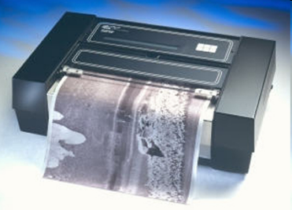
Thermal Printers
A thermal printer uses chemically-treated paper that becomes black when heated.
A thermal transfer printer uses heat-sensitive ribbon, which the print head melts onto the paper.
Thermal printers have a longer life because there are few moving parts.
Notes:
9.2.1.3 Thermal Printers
Some retail cash registers or older fax machines might contain
thermal printers. Thermal paper is chemically treated and has a
waxy quality. Thermal paper becomes black when heated. After
a roll of thermal paper is loaded, the feed assembly moves the
paper through the printer. Electrical current is sent to the
heating element in the print head to generate heat. The heated
areas of the print head make the pattern on the paper.

Slide 11
Thermal Printers (continued)
Advantages:
  Longer life because there are few moving parts
  Quiet operation
  No cost for ink or toner
Disadvantages:
  Paper is expensive.
  Paper has a short shelf life.
  Images are poor quality.
  Paper must be stored at
  room temperature.
Notes:
9.2.1.3 Thermal Printers

Slide 12
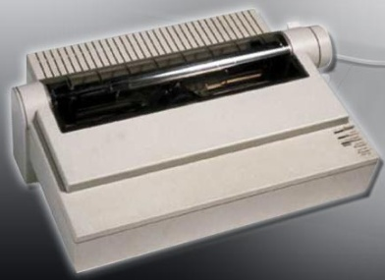
Impact Printers
Impact printers have print heads that strike an inked ribbon, causing characters to be imprinted on the paper
There are two types:
  Daisy-wheel
  Dot-matrix
Notes:
9.2.1.4 Describe impact printers
Impact printers form characters when the print head impacts a
printer tape or inked ribbon to create characters. Examples of
impact printers are Dot-matrix and Daisy-wheel.
Daisy-wheel printer - The wheel contains the embossed
letters, numbers, and special characters. Wheel is rotated until
the required character is in place, and an electromechanical
hammer pushes the character into the ink ribbon and against
the paper.
Dot-matrix printer - Print head contains pins that are
surrounded by electromagnets. When the electromagnets are
energized, the pins push forward onto the ink ribbon in
patterns, forming a character. The number of pins on a print
head, 9 or 24, indicates the quality of the print. The highest
quality of print that is produced by the dot matrix printer is
referred to as near letter quality (NLQ). Most dot-matrix printers
use continuous feed paper with perforations between each
sheet.

Slide 13
Impact Printers (continued)
Advantages:
  Uses less expensive ink than inkjet or laser printers
  Uses continuous feed paper
  Has carbon-copy printing ability
Disadvantages:
  Noisy
  Low-resolution graphics
  Limited color capability
Notes:
9.2.1.4 Describe Impact Printers

Slide 14
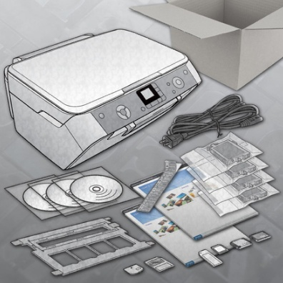
Installing and Configuring Printers
When purchasing a printer, the installation and configuration information is usually supplied by the manufacturer:
Installation media that includes drivers, manuals, and diagnostic software.
Also available as downloads from the manufacturer's website.
Although all types of printers are somewhat different to connect and configure, there are procedures that should be applied to all printers.
Notes:
9.3 Installing and Configuring Printers
When you purchase a printer, the installation and configuration information is usually supplied by the manufacturer. An installation CD that includes drivers, manuals, and diagnostic software will be included with the printer. The same tools may also be available as downloads from the manufacturer's website
9.3.1.1 Installing a Printer
Go through this checklist to prepare the printer for installation:
Once the printer has been unpacked and placed in position,
connect it to the computer, network, or print server and plug it
into an electrical outlet.
Check the box to ensure all required cables are provided.
Remove packing materials from the printer and plastic inserts from the consumables.
Place printer in position. Ensure that the printer location will not cause overheating.
Install the toner or ink cartridge in the printer.
Install paper trays.
Install paper.
Read and follow the instruction manual.
Connect cables.
Test print from computer.

Slide 15
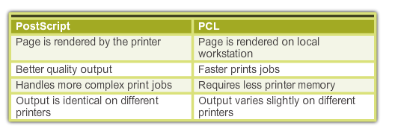
Installing and Configuring Printers (Continued)
Connect the Printer
  Connect the appropriate data cable to the communication port on the back of the printer.
  Attach the power cable to the printer.
  Warning: Never plug a printer into a UPS. The power surge that occurs when the printer is turned on will damage the UPS unit.
Printer Driver
  A printer driver is the software program that enables the computer and the printer to communicate with each other.
  It is recommendable to find out if a newer driver is available on the manufacturer’s website.
Notes:
9.3.1.1 Installing a Printer
If the printer has a USB, Firewire, or Parallel port, connect the corresponding cable to the printer port and to the corresponding port on the back of the computer. The local computer manages and sends the print jobs to the printer. Local printers can be shared over the network with other users.
If you are installing a network printer, connect the network cable to the network port. Most network connections use an Ethernet cable. The network printer allows multiple users to send documents to the printer over the network
9.3.1.2 Lab – Install a printer in Windows 7
9.3.1.3 Lab – Install a printer in Windows Vista
9.3.1.4 Lab – Install a printer in Windows XP
9.3.1.5 Types of Print Drivers
Printer drivers are software programs that make it possible for computers and
printers to communicate with each other. Configuration software provides an
interface that enables users to set and change printer options. Every printer model
has its own type of driver and configuration software.
Two common languages used in print drivers are Page Description Language
(PDL) and PostScript.
9.3.1.6 Updating and Installing Print Drivers
A printer driver is a software program that enables the computer and the printer to communicate with each other. The driver also provides an interface for the user to configure printer options. Each printer model has a unique driver. Printer manufacturers frequently update drivers to increase the performance of the printer, to add options, or to fix problems. You can download updated printer drivers from the manufacturer’s website.
Step 1: Determine if a newer driver is available.
Step 2: Download the printer driver files to your computer.
Step 3: Install the downloaded driver.
Step 4: Test the new printer driver.
Firmware is a set of instructions stored on the printer to control how the printer operates. You may wish to upgrade your printer's firmware if you encounter printing problems or need new features. The procedure to upgrade firmware is very similar to installing printer drivers. Download the upgrade file from the manufacturer's website and run a setup file that installs it.

Slide 16
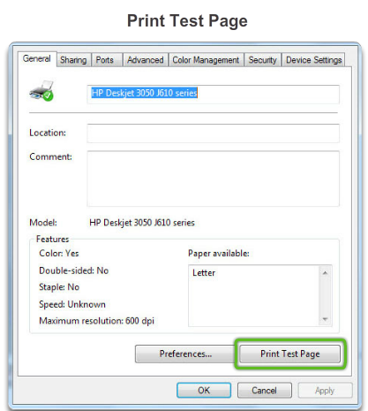
Installing and Configuring Printers (Continued)
Test Page Printing
  After installing a printer, you should print a test page to verify that the printer is operating properly.
  You can print a test page manually, from an application such as Notepad, or from the Command Line.
Notes:
9.3.1.7 Printer Test Page
After installing a printer, you should print a test page to verify the following:
The printer is operating properly
The driver software is installed and working correctly
The printer and computer are communicating
To print a test page manually, use the following path:
Windows 7:
Start > Devices and Printers> right click desired printer>Printer Properties > General Tab > Print Test Page
Windows Vista:
Start > Control Panel>Printers >right click desired printer>Printer Properties > General Tab > Print Test Page
Windows XP:
Start > Printers and Faxes> right click desired printer>Printer Properties > General Tab > Print Test Page

Slide 17
Common Configuration Settings
Configuration Options and Default Settings include:
  Paper type - Standard, draft, gloss, or photo
  Print quality - Draft, normal, or photo
  Color printing - Multiple colors is used
  Black-and-white printing - Only black ink is used
  Grayscale printing – printing using only black ink in different shades
  Paper size - Standard paper sizes or envelopes and business cards
  Paper orientation - Landscape or portrait
  Print layout - Normal, banner, booklet, or poster
  Duplex - Two-sided printing
Notes:
9.3.2 Configuring Options and Default Settings
9.3.2.1 Common Configuration Settings:
Paper type - standard, draft, gloss, or photo
Print quality - draft, normal, photo, or automatic
Color printing - multiple colors are used
Black-and-white printing - only black ink is used
Grayscale printing - color image printed with shades of black ink
Paper size - standard and nonstandard paper sizes
Paper orientation - landscape or portrait
Print layout - normal, banner, booklet, or poster
Duplex - normal or two-sided printing

Slide 18
Global and Individual Document Options
Global and Individual Document options
Global method – settings that affect all documents.
  In Windows 7, use this path to change global settings:
Start > Devices and Printers> right-click the printer
  In Windows Vista, use the following path:
Start > Control Panel > Printers > right-click the printer
  In Windows XP, use the following path:
Start > Printers and Faxes> right-click the printer
Per Document Method – change the document print settings for specific documents.
Notes:
9.3.2.2 Global and Individual Document Options

Slide 19
Software Optimization
Most optimization is completed through the software supplied with the drivers
Tools to optimize performance:
  Print spool settings - Cancel or pause current print jobs in the printer queue.
  Color calibration - Adjust settings to match the colors on the screen to the colors on the printed sheet.
  Paper orientation - Select landscape or portrait image layout.
Notes:
9.3.3 Optimizing Printer Performance
9.3.3.1 Software Optimization

Slide 20
Hardware Optimization
Firmware - controls how the printer operates. Check the manufacturer’s homepage for the availability of new firmware.
Printer Memory – upgrading memory increases the printing speed and enhances complex print job performance.
Additional upgrades:
  Duplex printing to enable dual-sided printing
  Extra trays and/ or specialized trays
  Network cards to access a wired or wireless network
  Firmware upgrades to add functionality or to fix bugs
Notes:
9.3.3.2 Hardware Optimization

Slide 21
Configuring Printer Sharing
In Windows 7, to connect to the printer from another computer follow these steps:
Step 1. Choose Start > Devices and Printers > Add a Printer.
Step 2. The Add Printer wizard appears.
Step 3. Select Add a network, wireless or Bluetooth printer.
Step 4. A list of shared printers will appear. If the printer is not listed, select The printer that I wanted is not listed.
Step 5. After selecting the printer, click Next.
Step 6. A virtual printer port is created and displayed in the Add a Printer window. The required print drivers are downloaded from the print server and installed on the computer. The wizard then finishes the installation.
Notes:
9.4 Sharing Printers
9.4.1.1 Configuring Printer Sharing

Slide 22
Configuring Printer Sharing
In Windows 7, to configure the computer with the printer attached to accept print jobs from other network users, follow these steps:
Step 1. Select Start > Control Panel > Network and Sharing Center > Change advanced sharing settings.
Step 2. Expand the network listing to view the network profile.
Step 3. If printer sharing is off, under File and printer sharing, select Turn on file and printer sharing, and then click Save changes.
Notes:
9.4 Sharing Printers
9.4.1.1 Configuring Printer Sharing

Slide 23
Wireless Printer Connections
Wireless printers allow hosts to connect and print wirelessly using Bluetooth, 802.11x, or infrared (IR).
Bluetooth - both the printer and the host device must have Bluetooth capabilities and be paired.
802.11x - printers are equipped with installed wireless NICs and connect directly to a wireless router or access point.
IR (infrared) - requires transmitters and receivers on both devices and a clear line of sight between the transmitter and receiver.
Notes:
9.4 Sharing Printers
9.4.1.2 Wireless Printer Connections

Slide 24
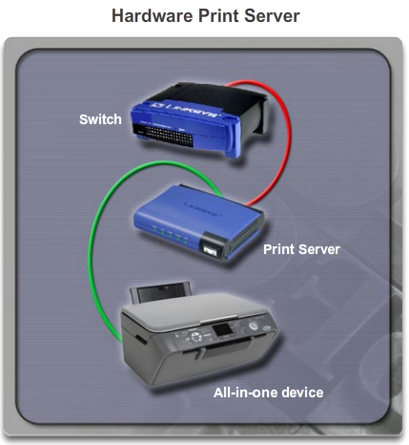
Print Servers
A print server has three functions:
  Provide client access
  Administrate print jobs
  Provide feedback to the users
There are three kinds of print servers:
  Network print server devices
  Dedicated PC print servers
  Computer-shared printers
Windows allows computer users to share their printers with other users on the network. There are two steps:
  Configure the computer attached to the printer to share the printer with other network users.
  Configure a user's computers to recognize the shared printer and print to it.
Notes:
9.4.2 Print Servers
9.4.2.1 Purposes of Print Servers
9.4.2.2 Network, Dedicated and Computer-Shared Print Servers
9.4.2.3 Lab – Share a printer in Windows 7
9.4.2.4 Lab – Share a printer in Windows Vista
9.2.4.5 Lab – Share a printer in Windows XP

Slide 25
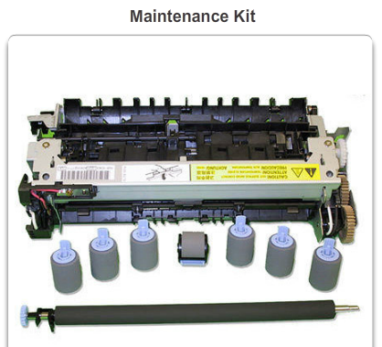
Preventive Maintenance Techniques
Preventive maintenance decreases downtime, increases service, guarantees good quality prints, and ensures uninterrupted operation.
Most manufacturers sell maintenance kits for their printers. For laser printers, the kit might contain replacement parts that often break or wear out:
  Fuser assembly
  Transfer rollers
  Separation pads
  Pickup rollers
Notes:
9.5 Preventive Maintenance Techniques for Printers
9.5.1.1 Vendor Guidelines
Printers have many moving parts that can wear out over time or through extended use. Moving parts can be affected by dust and other particles. Clean printers regularly to avoid downtime, loss of productivity, and high repair costs.

Slide 26
Preventive Maintenance Techniques (Continued)
Paper and Ink:
  Using the correct type of paper can help ensure that the printer operates longer and prints more efficiently.
  Types of printer paper available include inkjet and laser. Some papers, especially photo paper and transparencies, have a right and wrong side marked by an arrow on the package.
  Manufacturer will recommend the brand and type of ink to use. Do not refill ink cartridges because the ink may leak.
Notes:
9.5.1.2 Replacing Consumables
The paper and the ink used in a printer are important for the following reasons:
Paper selection - Many types of printer paper are available, including inkjet and laser. Paper packages are usually labeled with the type of printer for which it is intended. The manufacturer may recommend the type of paper that should be used for best results.
Ink selection - If the wrong type of ink is installed, the printer may not work or the print quality may be reduced. You should avoid refilling the ink cartridges because the ink may leak.

Slide 27
Preventive Maintenance Techniques (Continued)
Always follow the manufacturer's guidelines when cleaning printers.
CAUTION: Unplug printers before cleaning to prevent danger from high voltage.
Use the utility supplied by the manufacturer to clean the ink jet print heads.
When cleaning a laser printer, use a specially designed vacuum cleaner to pick up toner particles.
To extend the life of the thermal printer, clean the heating element regularly with isopropyl alcohol.
Notes:
9.5.1.3 Cleaning Methods
9.5.1.4 Operational Environment
9.5.1.5 Worksheet – Search for Certified Printer Technician Jobs

Slide 28
Troubleshooting Printers
Step 1 Identify the problem
Step 2 Establish a theory of probable causes
Step 3 Test the Theory to Determine cause
Step 4 Establish a Plan of Action to Resolve the Problem
and Implement the Solution
Step 5 Verify Full System Functionality and Implement
Preventative Measures
Step 6 Document Findings, Actions, and Outcomes
Notes:
9.6 Basic Troubleshooting process for printers
With printer, a technician must be able to determine if the problem exists with the printer, the cable connection, or the attached computer.
Follow the steps outlined in this section to accurately identify, repair, and document the problem:
Step 1 Identify the problem
Step 2 Establish a theory of probable causes
Step 3 Determine an exact cause
Step 4 Implement a solution
Step 5 Verify solution and full system functionality
Step 6 Document findings

Slide 29
Step 1 - Identify the Problem
Printer information
  Manufacturer, model, OS, network environment, connection type
Open-ended questions
  What problems are you experiencing with your printer?
  What software or hardware has been changed recently on your computer?
  What were you doing when the problem was identified?
  What error messages have you received?
Closed-ended questions
  Is the printer under warranty?
  Can you print a test page?
  Is this a new printer?
  Is the printer powered on?
Notes:
9.6.1.1 Identify the Problem
When a customer is not able to accurately describe the problem, there are other ways to evaluate the situation in the next steps of the troubleshooting process.

Slide 30
Step 2 - Establish a Theory of Probable Causes
Create a list of the most common reasons why the error would occur.
  Loose cable connections
  Errors on equipment display
  Errors on computer screen
  Equipment power
  Out of paper
  Printer queue
  Paper jams
  Low ink warning
Notes:
9.6.1.2 Establish a Theory of Probable Causes

Slide 31
Step 3 - Test the Theory to Determine cause
Test your theories of probable causes one at a time, starting with the quickest and easiest.
  Restart the printer
  Disconnect and reconnect the cables
  Restart the computer
  Check printer for paper jams
  Reseat paper in paper trays
  Open and close printer trays
  Ensure printer doors are closed
  Install a new link or toner cartridge
If the exact cause of the problem has not been determined after you have tested all your theories, establish a new theory of probable causes and test it.
Notes:
9.6.1.3 Test the Theory to Determine the Exact Cause
There are several hardware solutions that you can try:
You may also try software solutions to determine the solution:
Print from another application
Remove all print jobs from the queue.

Slide 32
Step 4 - Establish a Plan of Action to Resolve the Problem and Implement the Solution
Sometimes quick procedures can determine the exact cause of the problem or even correct the problem.
If a quick procedure does not correct the problem, you might need to research the problem further to establish the exact cause.
Divide larger problems into smaller problems that can be analyzed and solved individually.
Notes:
9.6.1.4 Implement a Solution
If a quick procedure does correct the problem, you can go to step 5 to verify the solution and full system functionality.
Evaluate the problem and research possible solutions. Divide larger problems into smaller problems that can be analyzed and solved individually. Prioritize solutions starting with the easiest and fastest to implement.
Check:
Helpdesk repair logs
Other techs
Manufacturer FAQs
Technical websites
News groups
Computer manuals
Device manuals
Online forums
Internet search

Slide 33
Step 5 - Verify Full System Functionality and Implement Preventative Measures
Verify full system functionality and implement any preventive measures if needed. Ensures that you have not created another problem while repairing the computer.
  Reboot the computer
  Reboot the printer
  Print a test page from the printer control panel
  Print a document from an application
  Reprint the customer’s problem document.
Have the customer verify the solution and system functionality.
Notes:
9.6.1.5 Review the troubleshooting process
Verify Solution and System Functionality

Slide 34
Step 6 - Document Findings, Actions, and Outcomes
Discuss the solution with the customer
Have the customer confirm that the problem has been solved
Document the process
  Problem description
  Solution
  Components used
  Amount of time spent in solving the problem
Notes:
9.6.1.6 Review the troubleshooting process
Document Findings

Slide 35
Common Problems and Solutions
Printer problems can be attributed to hardware, software, networks, or some combination of the three.
See chart of common printer problems and solutions in the curriculum 9.6.2.1.
Notes:
9.6.2.1 Common Problems and Solutions
[Direct the students to the curriculum to see all the charts explaining more common problems and solutions]
Printer problems can be attributed to hardware, software, networks, or some combination of the three. You will resolve some types of printer and scanner problems more often than others.
Other common printer problems and possible causes to consider:
Problem: Page is blank
Possible causes might be toner is empty, transfer corona assembly is malfunctioning, or the high voltage power supply which powers the charging and corona assemblies is malfunctioning
Problem: Page is completely black
Possible cause might be charging corona wire is malfunctioning
Problem: Recurring marks on page
Possible causes might be damage to the drum or toner spilled on one of the rollers.
Problem: Vertical black lines on page
Possible causes might be damage to the drum and dirty charging corona wire
Problem: Vertical white lines on page
Possible cause might be spilt toner on the charging corona wire
Problem: Smudging of image
Possible cause might be fuser is malfunctioning
Problem: Ghosting of image
Possible cause might be damaged cleaning scraper
Problem: Unintelligible text
Possible causes might be printer driver is malfunctioning or formatter board is malfunctioning

Slide 36
Chapter 9 Summary
Some printers have low output and are adequate for home use, while other printers have high output and are designed for commercial use.
Printers may have different speeds and quality of print. There is also a difference in price between the types of printers.
Newer printers typically use USB or Firewire cables and connectors.
Most printers also have an NIC port to connect to a network or they can connect wirelessly.
Notes:
Chapter 9 Summary

Slide 37
Chapter 9 Summary
Newer printers usually need only be connected to the computer and the computer will automatically install the necessary drivers.
If the device drivers are not automatically installed by the computer, you will have to use the drivers from CD or download from the manufacturer website.
Most optimization is done through software drivers and utilities.
Once you have set up the printer, the device can be shared to other users on the network. This is cost-efficient as there is no need for every user to have a printer.
Notes:
Chapter 9 Summary

Slide 38
Chapter 9 Summary
It is important to know how to properly configure local and networked printers, as well as which options are automatically installed through PnP.
A good preventative maintenance program will extend the life of the printer and keep it performing well.
Troubleshooting printer problems requires the technician to identify, repair, and document the problem.
Troubleshooting steps include: identify the problem, establish a theory of probable causes, determine an exact cause, implement a solution, verify solution and full system functionality, and document findings.
Notes:
Chapter 9 Summary

Slide 39


